Slide 1
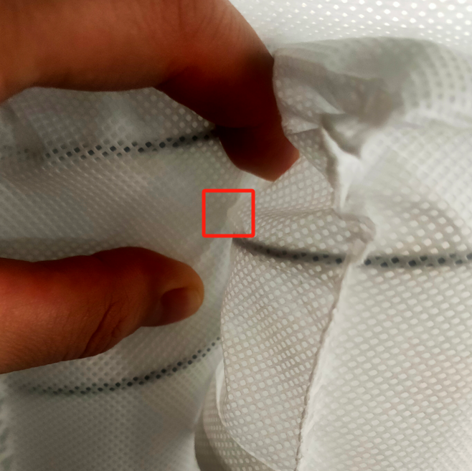
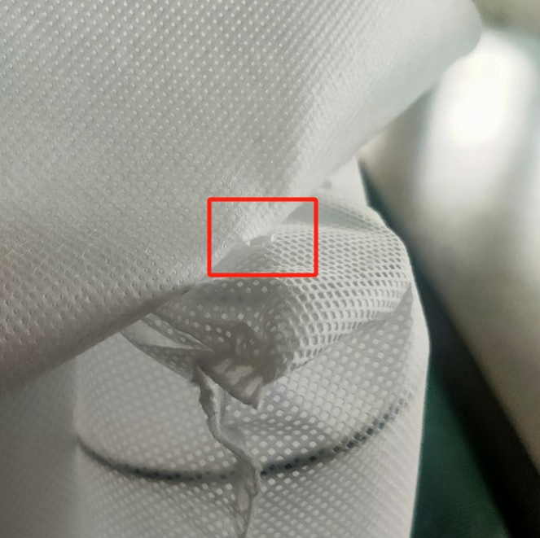
Application Products
Springs are crucial components that provide support for mattresses. Individual springs are placed into bags made of non - woven fabric, and then these bagged springs are arranged and connected together by machine or manually to form a spring mattress core.
The "UNISN" hot - melt adhesive for mattresses is mainly used to tightly connect components such as the mattress fabric with the internal spring bags and between spring bags.

Slide 2
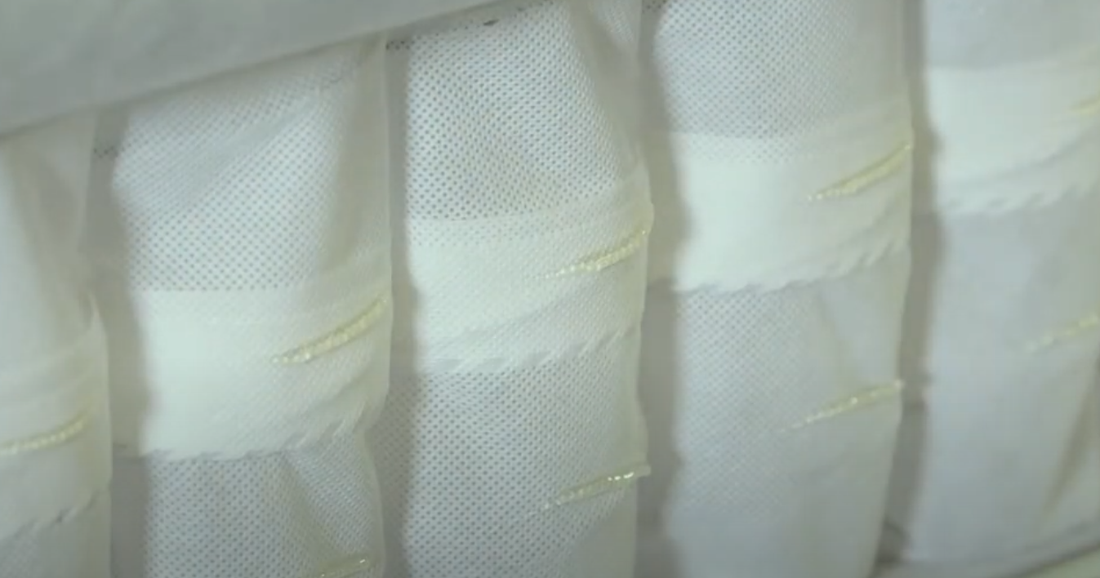
Application Equipment
Hot - melt Adhesive Coating Machine: This equipment first heats and melts solid hot - melt adhesive into a liquid state, and then uses a pressure device to transport the liquid hot - melt adhesive to the coating head.
Glue Sprayer: It atomizes the glue using compressed air and evenly sprays it onto the surface of the mattress fabric or spring bags through a spray gun. Then, the materials are quickly bonded by pressing them together.
Roll Coater: The rotating roller evenly transfers the glue onto the mattress fabric. After that, the fabric coated with glue is pressed against the spring bags for bonding.
Laminator: Its main function is to accurately bond the mattress fabric coated with glue and the spring bags, and apply a certain pressure to make them tightly combined.
Spray - bonding between non - woven fabric spring bags.

Slide 3
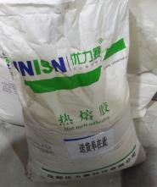
Why Choose UNISN Hot - melt Adhesive
Fast Melting Speed: It can transform from a solid state to a liquid state in a relatively short time, allowing it to be used quickly and improving production efficiency.
Good Fluidity: It can be quickly and evenly coated on the surface of the adherend and fit well, ensuring the integrity of the bond.
Fast Curing Speed: It enables the adherends to be fixed quickly, greatly shortening the production cycle.
High Bonding Strength: It has good bonding performance with a variety of materials, ensuring that the bonded objects will not easily fall off or separate.
Good Anti - brittleness Property: Under the long - term influence of external forces during the use of the mattress, it can maintain good flexibility and bonding strength, and is not prone to brittle fracture or glue - off.
Good High - Temperature Resistance: In a certain high - temperature environment, it can still maintain good bonding strength and stability, making it suitable for high - temperature environments.
Environmentally Friendly and Harmless: It is made from environmentally friendly raw materials, causing no pollution to human health and the environment. It can be widely used in fields with high environmental requirements.
Low Odor: It can avoid the emission of pungent or unpleasant odors, which is user - friendly for product users.

Slide 4
Usage Methods and Precautions
Open Time: 10 - 20 seconds
Operating Temperature Settings: Glue melting tank: [temperature value not specified in the original, you can check and fill in accurately]; Hose and spray gun: 150 - 180°C. Note: In cold environments, the hot - melt adhesive dissipates heat quickly, and the operating temperature of the hot - melt adhesive needs to be increased by at least 5°C.
In addition, note the following:
Pre - heat the glue - melting device for about 2 hours first.
Control the amount of glue added according to the production volume to prevent over - heating due to incomplete consumption over a long period, which may cause the glue to age and affect its adhesion. Also, avoid insufficient consumables, which may affect glue spraying.
After replenishing consumables, reseal the packaging bag and cover the glue - melting tank to prevent impurities from mixing in and blocking the hose and spray gun.
The use place should be well - ventilated and kept away from open flames.
Since the glue - melting tank and the glue - spraying system are at high temperatures, safety protective equipment must be worn during operation to prevent burns.
Avoid contact between the melted glue and parts such as eyes and skin.
If the melted glue comes into contact with the skin, immediately immerse the affected skin in cold water and rinse for at least 10 minutes. Seek medical treatment in a timely manner after cooling.

Slide 5
FAQ
Production Anomaly | Cause Analysis | Solutions
Brittle Glue Fracture | Product issues | Adjust the product
Poor Atomization Effect | Low temperature | Appropriately increase the temperature
 | Poor product compatibility | Adjust the product
High - temperature Separation | Low softening point | Increase the softening point of the product
Severe Yellowing / Carbonization | High temperature | Adjust it appropriately to a suitable temperature.
 | Poor anti - aging performance of the product | Adjust the anti - aging formula of the product
Unstable Glue Spraying | Pressure issues, blockage | Check the equipment pressure system and glue - spraying system
 | Uneven product melting | Adjust the product

Slide 6
Thank You for Your Attention!
Sichuan UNISN New Material Technology Co., Ltd.
Office Address: Room 806, Building 5, China Railway West City Business District, Qingyang District, Chengdu,
Sichuan Province,
China
Tel: +86 028-81726336 Fax: +86 028-81766336
Mobile: +86 138 8208 4297 Email: unisn@foxmail.com

